Slide 1
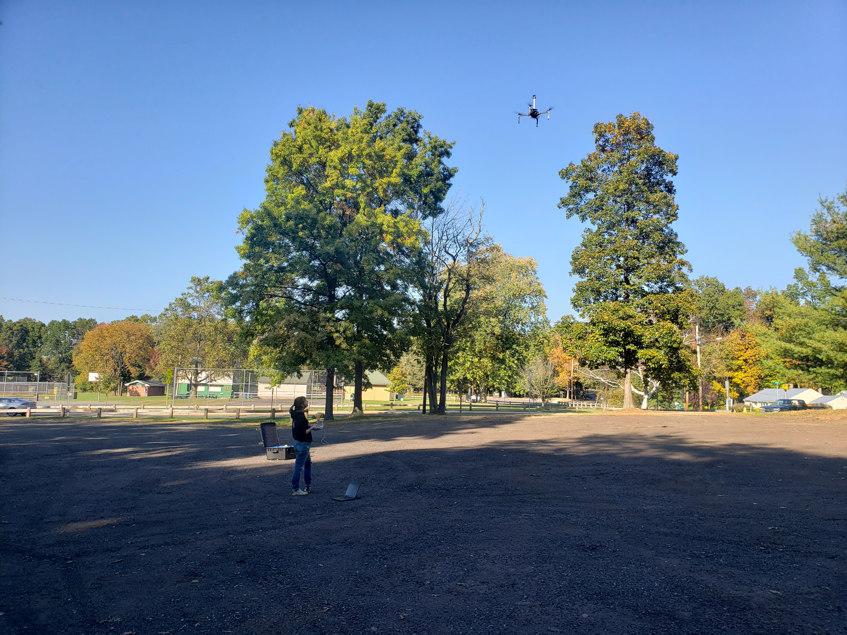
How did I get here?!
Mads O’Brien, MESc 2020
November 11, 2019

Slide 2
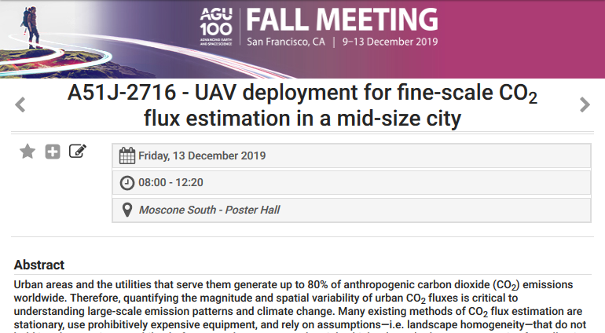
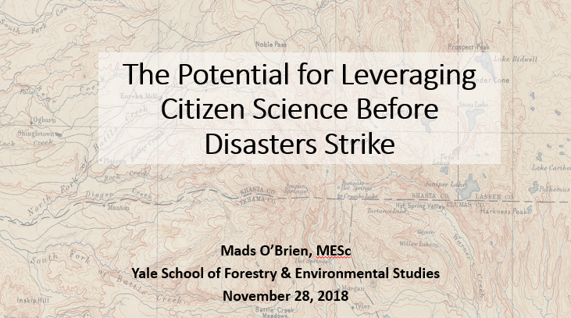
Research Methods proposal
Presenting my current thesis at a conference

Slide 3
Timeline
August 2018 – Very eager MESc with a PLAN!
December 2018 – Complete research proposal
Jan – March 2019 – “Networking”, supposedly…
March 7, 2019 – “Oh god, what am I doing…” A Reckoning
April – May 2019 – Quickly arrange new plan for summer
Notes:
Completely changed my thesis based on what was feasible
Make flowchart of my spring semester… and how it completely changed

Slide 4
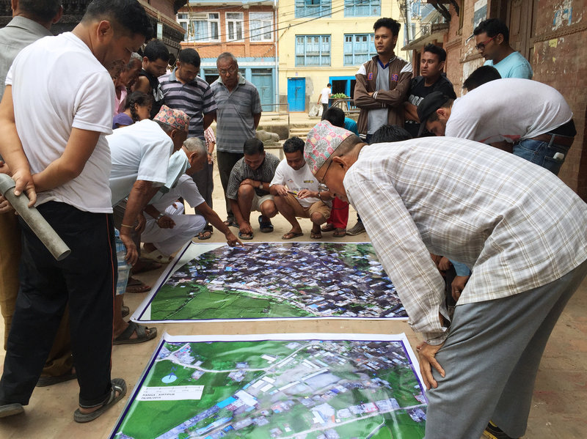

Research Questions
How is VGI currently integrated into environmental disaster monitoring and response?
How may VGI collected in non-crisis contexts be incorporated into baseline knowledge of vulnerable places?
What are the benefits and barriers to using citizen science data in disaster monitoring and response, according to geospatial and environmental practitioners? What themes emerge?
Notes:
A mere question, however, does not identify a problem, that is, a conflict or something unsettled, perplexing, vexing, distressful, and in the need of
investigation.
So, remember to define the PROBLEM
https://www.npr.org/sections/parallels/2016/10/02/495795717/when-disaster-strikes-he-creates-a-crisis-map-that-helps-save-lives
Really, I wanna know
What would a world look like where both data forms are easily commensurable and actively shared? What must occur to make that world a reality?
How different are citizen science data and crisis mapping data, really?

Slide 5




Major Actors… and Potential Partners for Case Study
World Food Programme (Rome, Italy; or other country office)
Harvard Humanitarian Initiative (Cambridge, MA)
U.S. Geological Survey (Menlo Park, CA; Flagstaff, AZ; Vancouver, WA)
Federal Emergency Management Agency (FEMA)
U.S. Forest Service
Humanitarian OpenStreetMap Team
National Phenology Network
PublicLab
Notes:
Ones with locations listed are places I have contacts

Slide 6
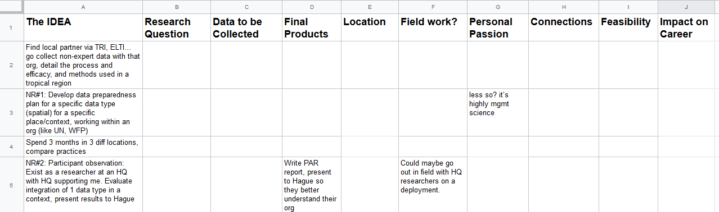
TIP: Narrow down ideas with a “Rubric”
Rank each project idea against what you want / what you value
Assign each column a value 1-5 (plus notes)

Slide 7
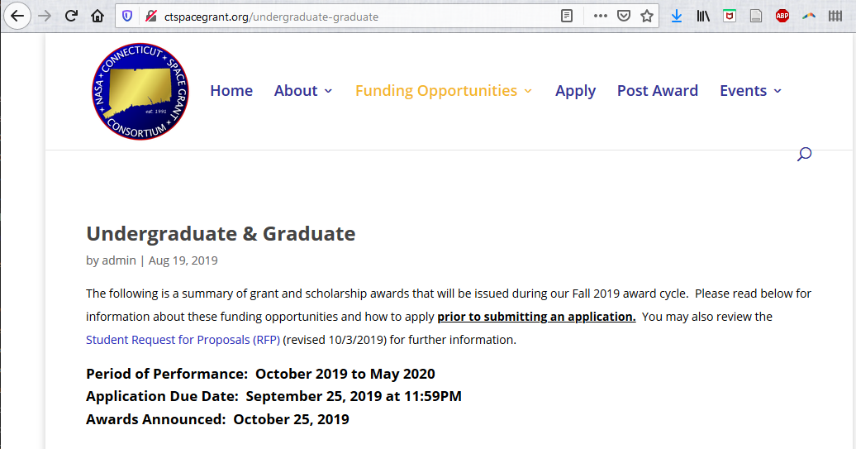
TIP: Ask profs where THEY get funding

Slide 8
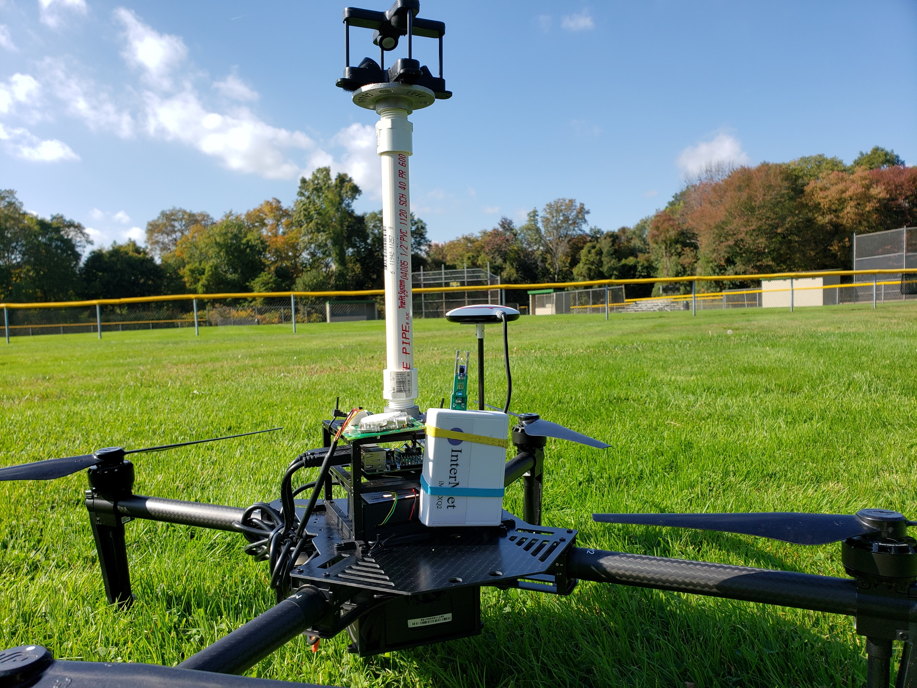
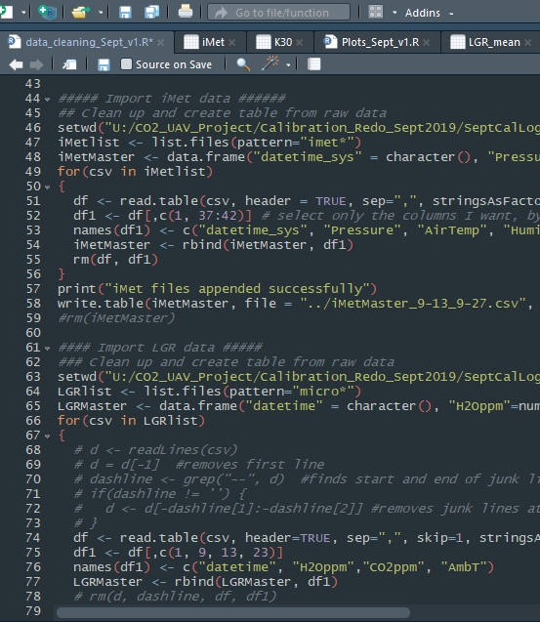
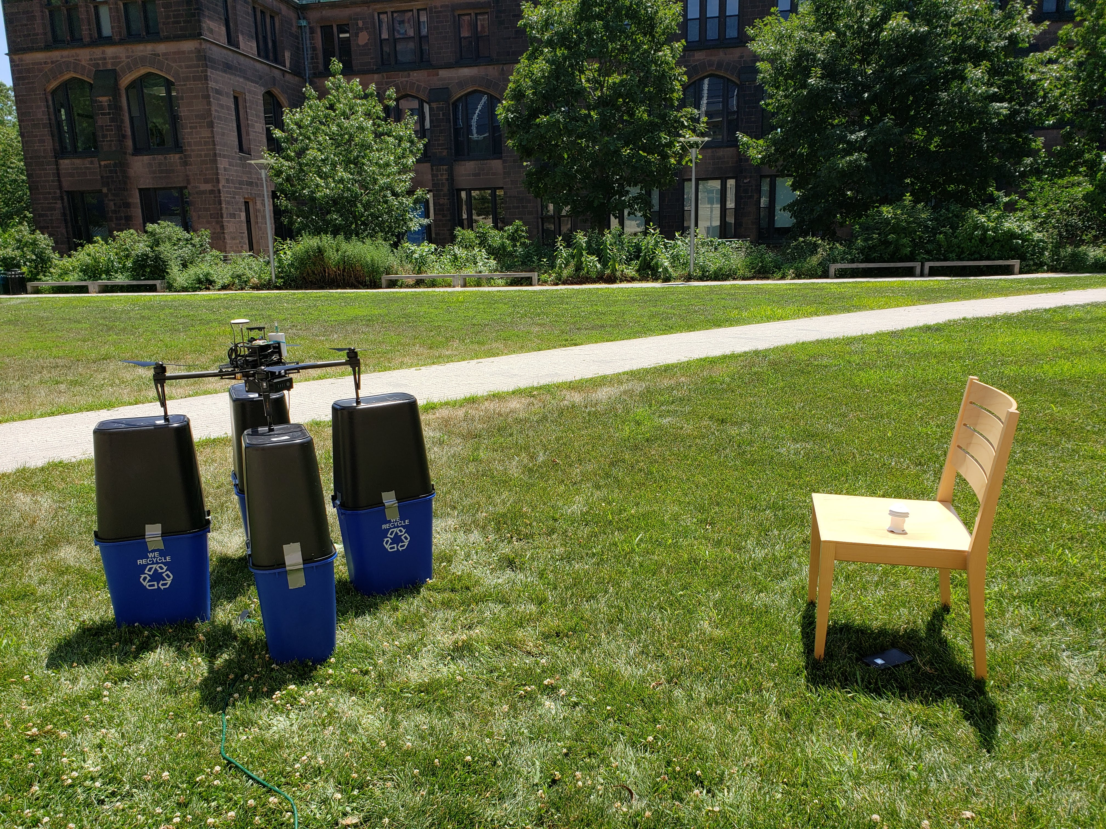
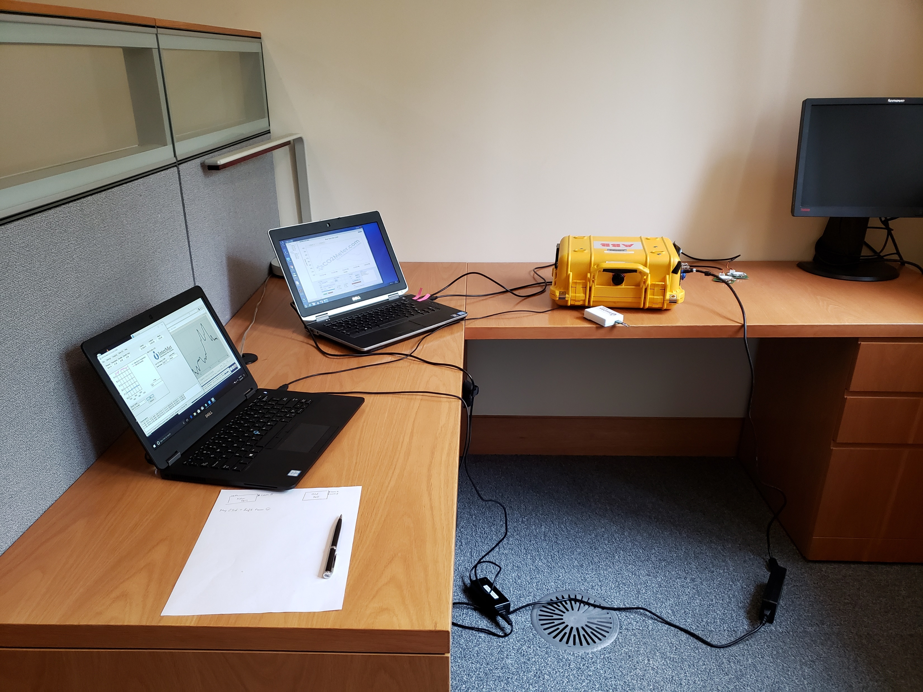
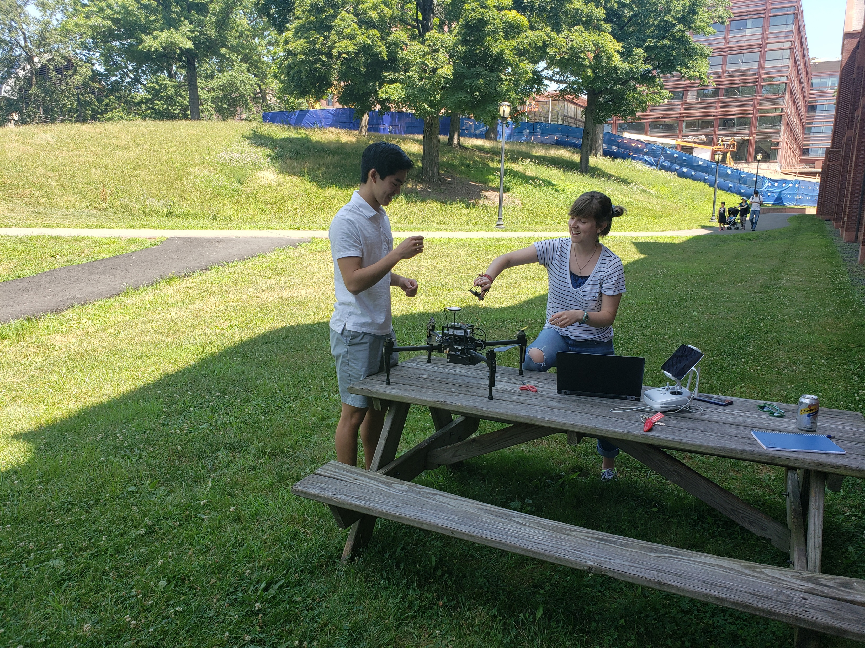
What I did this summer!
Notes:
Describe my project

Slide 9
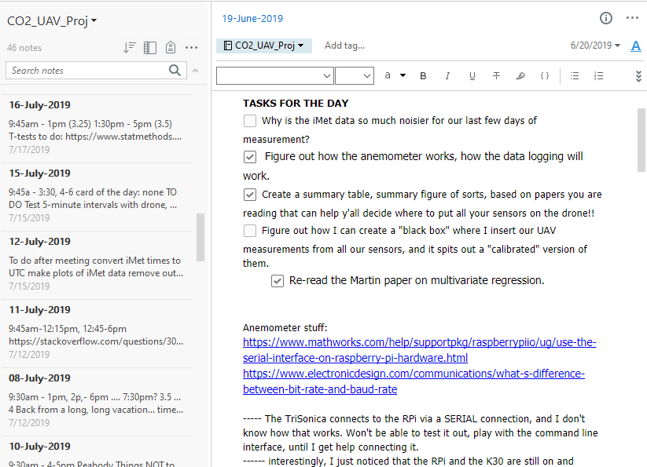

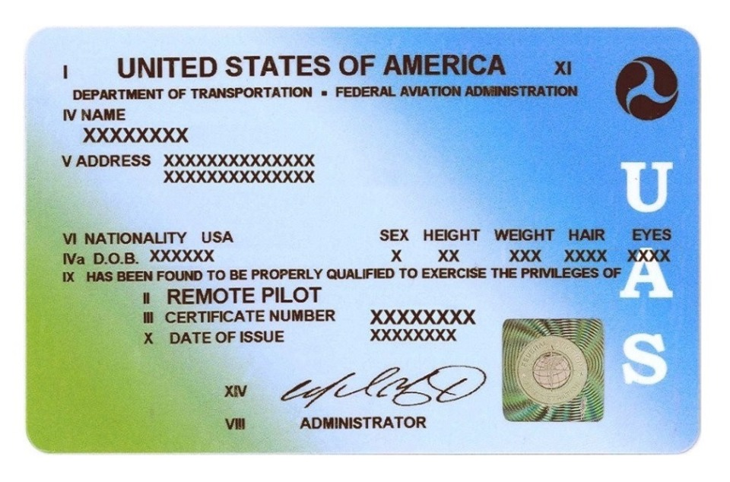
TIPS: During the summer…
Take EXCELLENT notes
Time is against you, so don’t be afraid of front-loading and burning out.

Slide 10
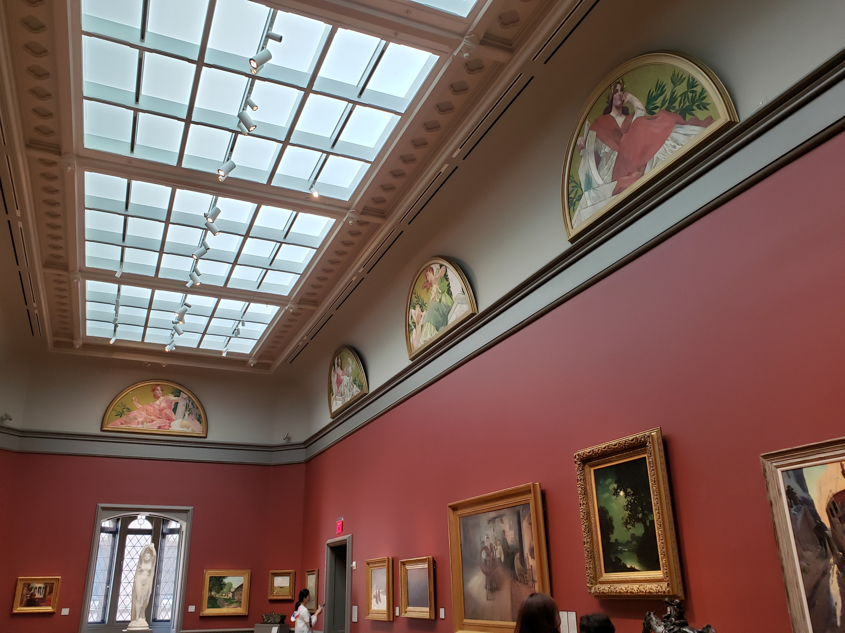
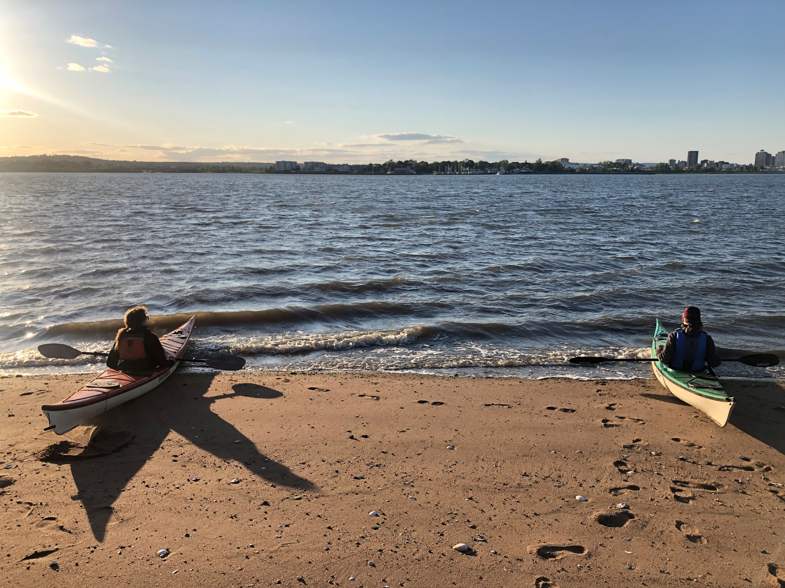
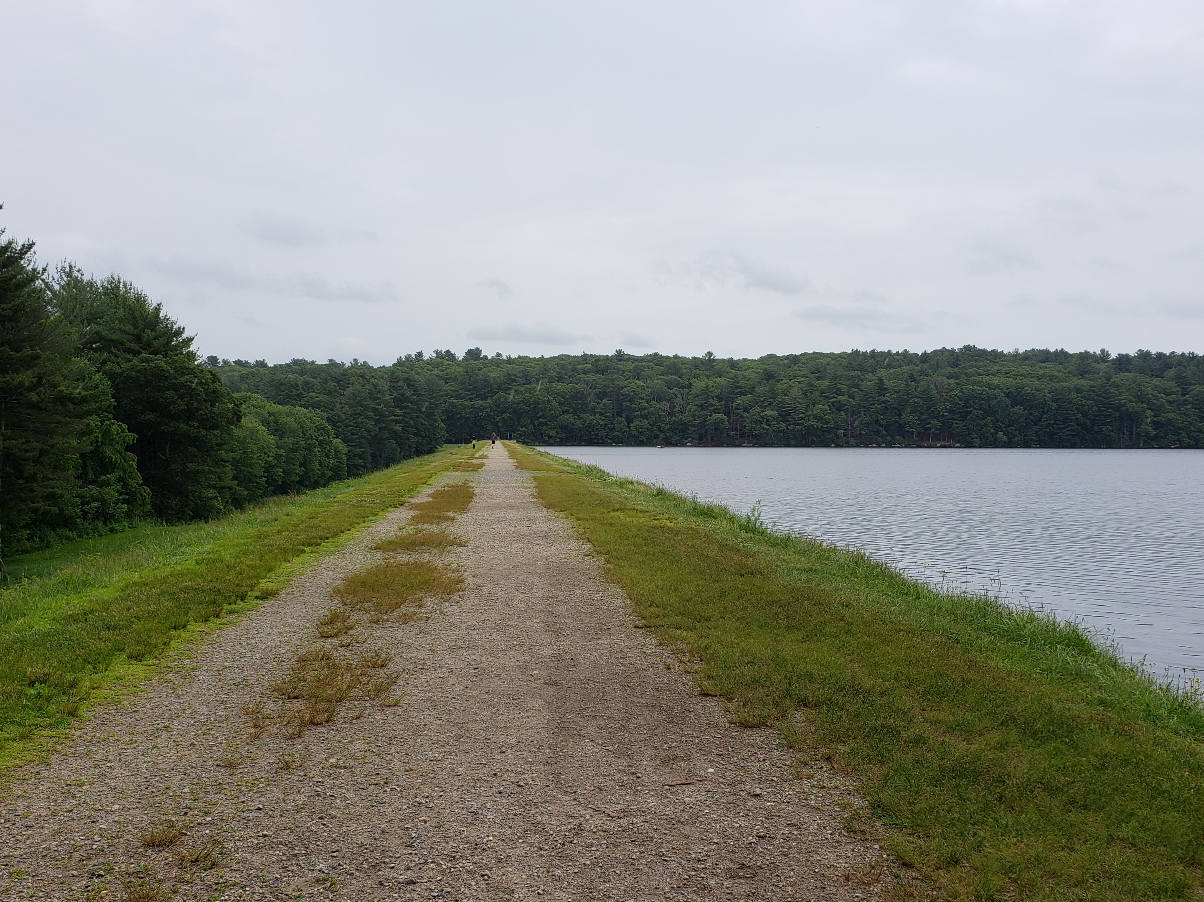
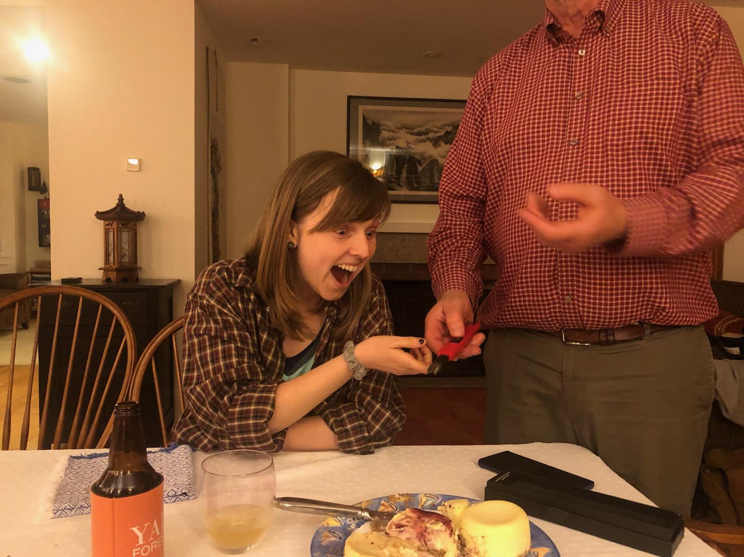

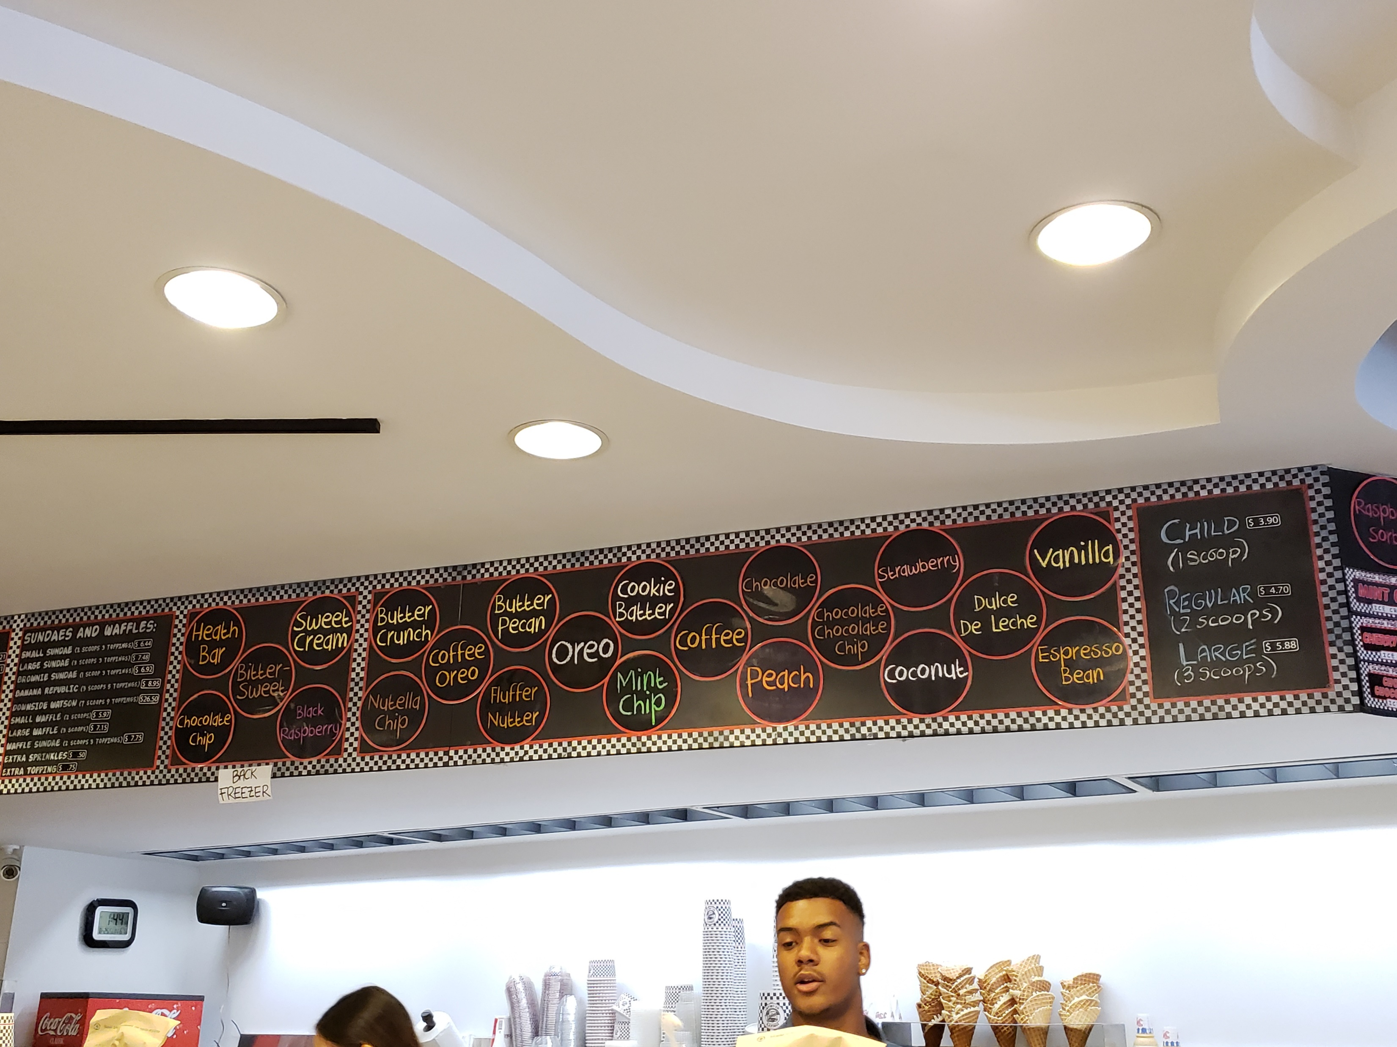
Summer in New Haven!
Notes:
Bonfires, ice cream, film festival

Slide 11
Summary take-aways
As you consider projects, keep your ideas all in one place (Dropbox, Google Drive, Evernote)
Apply for funding even if your project description might totally change – FES funding sources understand that!
It’s ok to completely shift gears, especially to something more feasible… But do so responsibly
Your relationship with your boss / collaborators can make or break your experience

